Slide 1
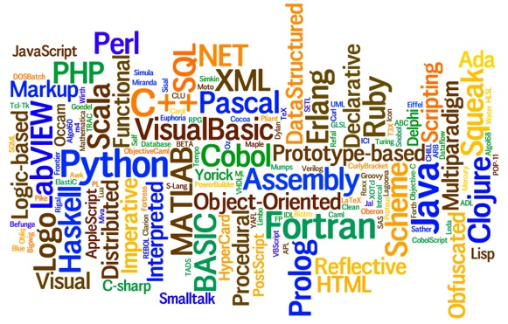
Programming Languages – Lec 1
By Talha Waheed, UET, Lahore

Slide 2
Questions to be Answered
Why are there so many different programming languages?
How and why they are developed?
What is the intended purpose of a language?
In what ways are they similar?
What are the differences among them?
Why wouldn’t we simply continue to use what we have today?
What kinds of programming languages may be developed in future?

Slide 3
We will Discuss
Design issues of various languages
Design choices and alternatives
Historical context and specific needs
Implementation issues

Slide 4
Text Book: Concepts of Programming Languages, 10 ^{th} Ed. (or 9th )
By Robert Sebesta

Slide 5
Reasons to study concepts of Programming Languages
Increased capacity to express programming concepts
Improved background for choosing appropriate languages
Increased ability to learn new languages
  Design methodologies
Understanding the significance of implementation
Increased ability to design new languages

Slide 6
Increased Capacity to express programming concepts
The tools we use have a profound (and devious!) influence on our thinking habits, and, therefore, on our thinking abilities.
Edsger Dijkstra
Depth at which we can think is influenced by the expressive power of the language.
What kind of algorithms can you develop.
Can increase the range of software development thought process by learning new languages.
Those constructs can be simulated

Slide 7
Improved background for Choosing appropriate languages
"To the man who only has a hammer in the toolkit, every problem looks like a nail."
Abraham Maslow
Sometimes, some programming languages are more suitable for a specific task.
  Special purpose languages: Snobol

Slide 8
Better understanding of significance of implementation
In some cases, an understanding of implementation issues leads to an understanding of why languages are designed the way they are.
Leads to efficient use of the language.
  Row vs. column major
  recursion
Certain bugs can only be found and fixed if the programmer knows some related implementation details.

